Slide 1
Operating Systems and
System Programming
Software College of SCU
四川大学软件学院 左航
2380588@qq.com
Notes:
3节理论课 1 至16x+y结束，剩下的后2节
Welcome back, today we will move to unit 3.
Clues: CPU 如何执行指令，对应的硬件结构，那么代码和数据的获取方式---哪些REGISTERS，程序如何寻址，哪些指令，最后如何编写汇编程序，如何阅读C对应的汇编，完成实验
按照后面的介绍生成一个机器码，数据，指令，汇编， 高级语言对照的例子

Slide 2
Unit 3. Representation of Code
3.0 Brief Introduction :SSD6 1.5
3.1 X86 Instructions
3.2 x86 Assembly Language Programming
3.3 Disassembly in VS C++IDE
3.4 Machine Code
201001V1.1
Notes:
We have learned the representation of characters, integers and float-point numbers last week. Compilers translate program statements into detailed instructions to the CPU. We should also ask what these instructions look like and where they reside. Today we continue the representation topic and move to the code part—representation of code. And we also will detail how to write an assembly program. Let’s jump directly to the brief introduction.

Slide 3
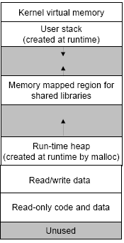
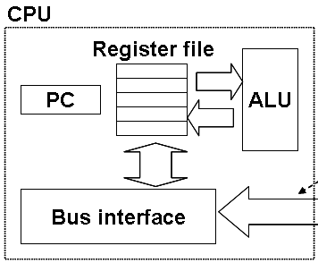
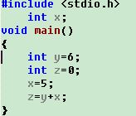
3.0 Brief Introduction (1/4)
    a CPU can not understand
    "c = (a + b) * d"
201001V1.1

Slide 4
3.0 Brief Introduction(2/4)
    But A CPU can understand: "Add the contents of these two registers together and put the result in the first one."
You will learn
  Assembly language Review
  C statements VS Assembly language instructions
After that you can
  Optimizing program performance
    After you know better about how program works on CPU
  Understanding C from low level
201001V1.1
Notes:
In this unit you are going to learn some issues about assembly language and this will help you to optimize program performance.
In fact, optimizing the program by assembly language is a very complicated and professional task, compiler can do this job for us, and most of the time, do it in an amazing way than we could, since the designers of the compiler have an deep and entire understanding of how the machine codes and the hardware are cooperated. To optimize by replace the c instructions with the assembly instructions is recommended only when you fully understand the shortcome and limitations the compiler and can only be done in some special situation.

Slide 5
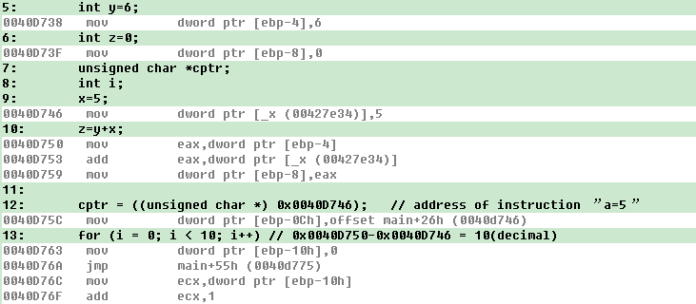
3.0 Brief Introduction (3/4)
The code and data are stored in memory separately.
  Code(cs+ip): mov eax,dword ptr[ebp-4]
  Data(stack+ebp): in stack, accessed via [ebp-4]
To show this window:
Debug ->Windows->Disassembly
201001V1.1
Notes:
Ok, in this disassembly window, the black lines are C instructions and the gray lines follow it are the corresponding assembly language. As we can find, some C instructions is translated one to one, and others may be one to many. Like the addition instruction in the 10th is translated to 3 assembly instructions. If you choose the optimization option during compilation, the relation between c and assembly instructions may be difficult to understand. In this example we choose to disable the optimization option.
To answer the first question, look at the front part of the gray line, it’s the address in where the machine codes reside, once again, the address of the machine code, not address of the assembly instruction. Since during the execution all the bits stream in virtual memory are either machine code or data, not assembly instructions.
Answer to the second question: subtract the previous address from the following one, we will get the length of the machine code. 50-46 in hexadecimal, we get 10 in decimal.

Slide 6
3.0 Brief Introduction(4/4)
Once complied, no identifiers(对象名) survived. All data must be saved in code, memory or registers.
  You must know Registers in CPU and Addressing Mode before you start to learn assembly instructions.
201001V1.1
Notes:
After we go through the detail of instruction encoding, now lets move to the execution part. Execution contains two stages, fetch stage and execute stage.
Processor Fetches instructions from memory. Processor Executes each instruction.
These two stages work simultaneously.

Slide 7
Unit 3. Representation of Code
3.0 Brief Introduction
3.1 X86 Instructions
3.2 x86 Assembly Language Programming
3.3 Disassembly in VS C++IDE
3.4 Machine Code
201001V1.1
Notes:
Lets move to the x86 instructions part.

Slide 8
3.1 8086 Instructions
3.1 8086 Instructions
  3.1.1 Registers in CPU
  3.1.2 Operand-addressing Mode
  3.1.3 Instruction Set
201001V1.1
Notes:
Let’s begin with operand-addressing mode. What is the addressing mode ?

Slide 9
3.1.1 Registers in CPU(1/3)
8086 Register(16bits)/ Real Mode
ax | 累加器 | 加法乘法指令的缺省寄存器, 函数返回值
cx | 计数器 | REP & LOOP指令的内定计数器,字符串长度
dx | 除法寄存器 | 存放整数除法产生的余数
bx | 基址寄存器 | 在内存寻址时存放基地址
sp | 栈顶指针寄存器 | SS：SP当前堆栈的栈顶指针
bp | 栈底指针寄存器 | SS：BP当前堆栈的栈底指针
si, di | 源、目标索引寄存器 | 在字符串操作指令中，DS：SI指向源串 ES：DI指向目标串
ip | 指令寄存器 | CS:IP指向下一条指令的地址
Flags/PSW | 标志寄存器 | 标志寄存器
cs | 代码段寄存器 | 当前执行的代码段
ss | 椎栈段寄存器 | stack segment, 当前堆栈段
es | 附加段寄存器 | 指出当前程序使用附加数据段的段基址， 该段是串操作指令中目的串所在的段
ds | 数据段寄存器 | data segment, 当前数据段
201001V1.1
Notes:
This table lists all the registers in CPU chip and their special application. Ax is often used in doing addition. Cx used as a counter register to record the number of iteration. Sp and bp usually holds the effective address or offset of the stack. Si and di are used in string relative operations, such as string copy. Cs ss, es and ds hold the addresses of corresponding segment.

Slide 10
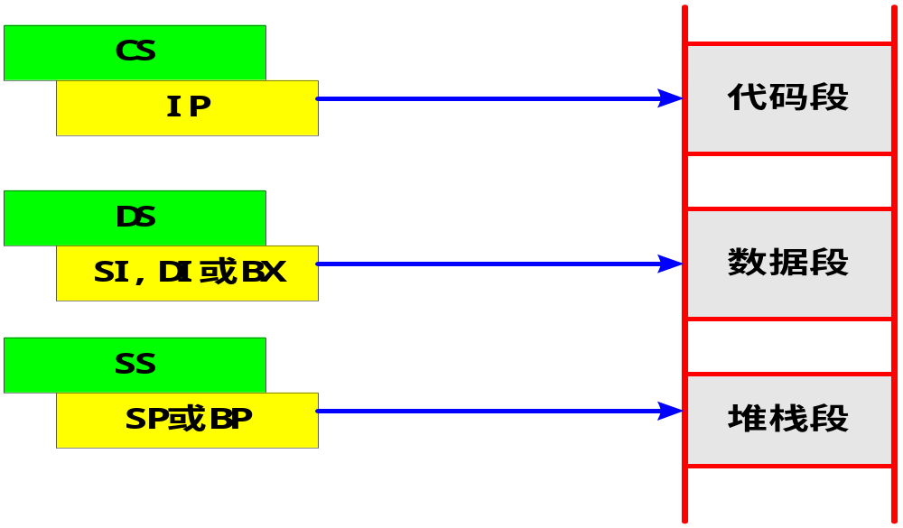
3.1.1 Registers in CPU(2/3)
Memory Addressing
段寄存器Segment register
  mov ax, [ebp-4]
ES
Extra segment 附加段，往往在串操作时使用，类似数据段（可和数据段重叠）
201001V1.1
Notes:
In the above pages, we see how to access a global variable through the absolutely address and local variable in stack through the relative address stored in ebp.
At the same time, the address of an instruction is located by ip register, or so called the program counter, in code segment. By the combining of the relative address in IP or EBP to the segment address in CS or SS, we can the absolute memory address of a CPU instruction or a data..
The combination modes used to access data, stack and code are listed in this figure. All this combinations are used in a real mode.
段寄存器：在8086系统中，访问存储器的地址码由段地址和段内偏移地址两部分组成。段寄存器用来存放各分段的逻辑基值，并指示当前正在使用的4个逻辑段，包括代码段寄存器CS、堆栈段寄存器SS、数据段寄存器DS和附加段数据寄存器ES。
1， 代码段寄存器CS：存放当前正在运行的程序代码所在段的段基值，表示当前使用的指令代码可以从该段寄存器指定的存储器段中取得，相应的偏移值则由IP提供。
2， 数据段寄存器DS：指出当前程序使用的数据所存放段的最低地址，即存放数据段的段基值。
3， 堆栈段寄存器SS：指出当前堆栈的底部地址，即存放堆栈段的段基值。
4， 附加段寄存器ES：指出当前程序使用附加数据段的段基址，该段是串操作指令中目的串所在的段。

Slide 11
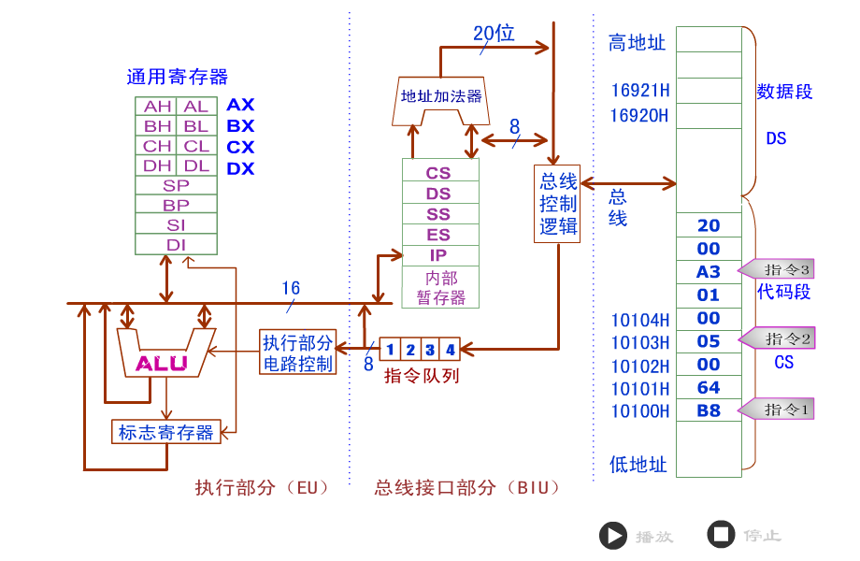
3.1.1 Registers in CPU(3/3)
201001V1.1
Notes:
We are going to play an animation to illustrate how the CPU fetch and execute the instruction. The CPU contains two units, one is execution unit, in charge of execute the instruction on alu. The other part is bus interface unit, in charge of calculating the address and fetch instruction and data. 1, figure out the address by adding ip to the cs, 2, then fetch instruction from the address 3, transfer the instruction to the instruction sequence and wait for execution. During the execution process the content in ip may be changed by a branch instruction, like condition jump or function call, but programmers are forbidden to change the ip explicitly.

Slide 12
3.1 8086 Instructions
3.1 8086 Instructions
  3.1.1 Registers in CPU
  3.1.2 Operand-addressing Mode
  3.1.3 Instruction Set
201001V1.1
Notes:
Let’s begin with operand-addressing mode. What is the addressing mode ?

Slide 13
3.1.1 Operand-addressing Mode (1/8)
Opcode Operand
  Opcode：操作码，指令
  Operand：操作数/操作数的地址
    Operand Addressing determines which data item will be fetched at each step of an instruction's execution
    In c : use a variable
    In machine code : operand-addressing mode(访问操作数的模式,register /mem/imm)
201001V1.1
Notes:
Operand addressing mode determines which data item will be fetched and where to fetch it. In c, we use variable, no matter it is global or local, static or dynamic, and this makes things easier and enable the programmer to focus on solutions of problems. But in machine code, there is no such things like variable, we use addresses to access data, so operand addressing mode is important here.
Operand-addressing mode can be classified into 3 categories.

Slide 14
3.1.1 Operand-addressing Mode (2/8)
Data-addressing Mode Classified in X86
  Immediate立即数: mov ax,10H (Where is data stored?)
  Register ： mov ax,bx
  Memory: mov ax, [10H] mov ax, [bx]
    直接寻址(direct addressing)
    寄存器间接寻址(register indirect addressing)
    寄存器相对寻址(Register relative Addressing)
    基址加变址寻址 (base-plus-index addressing)
    相对基址变址寻址(base relative-plus-index addressing)
    比例变址寻址(scaled-index addressing)
201001V1.1
Notes:
the first category is register addressing, it indicates both operands in this mode must be registers.
The second category is immediate addressing, it indicates the source operand must be a constant and the destination register must be a register.
The third one is memory addressing which contains 6 different mode. It indicates that one and only one operand must be a memory address, the other operand can be a immediate number or a register.
Despite which addressing mode we use, there are some rules to be followed.
1. Immediate number can only appears as source operand.
2. memory-to-memory operation is not allowed except string operations
3. avoid using segment register.

Slide 15
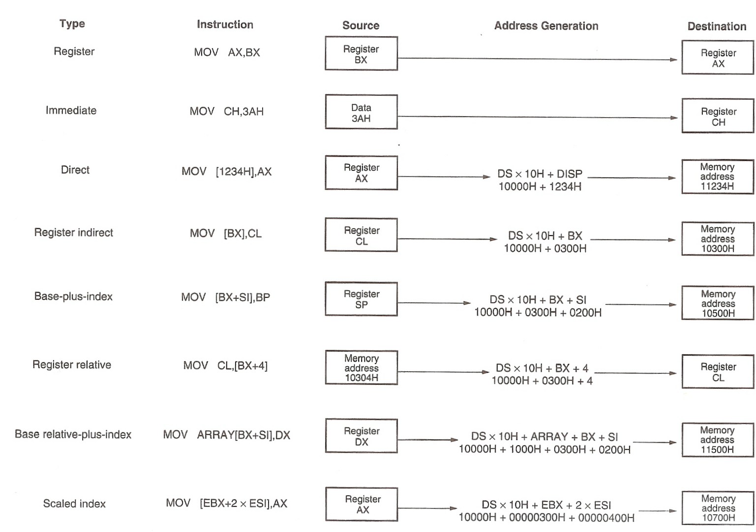
3.1.1 Operand-addressing Mode (3/8)
201001V1.1
Notes:
Here is a profile of all these 8 addressing modes. Lets discuss some typical ones.

Slide 16
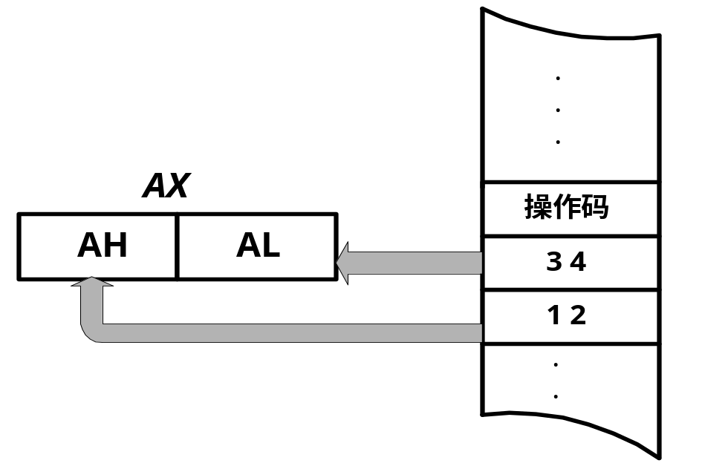
3.1.1 Operand-addressing Mode (4/8)
1)Immediate Addressing立即寻址
  MOV AX，1234H
  Save 1234H in register AX。
opcode
Code section
201001V1.1
Notes:
This picture shows how an immediate addressing mode works, the immediate data will be stored in the destination register ax.
Remember that first Immediate number can only appears as source operand; seconde, the immediate data is stored in the code segment with the opcode.

Slide 17

3.1.1 Operand-addressing Mode (5/8)
2） Register Addressing 寄存器寻址
  All operands are registers
    16位操作数: AX，BX，CX，DX，SI，DL，SP,BP；
    8位操作数: AH，AL，BH，BL，CH，CL，DH或DL。
  MOV AX，BX ；Copy value saved in BX to AX。
201001V1.1
Notes:
In register addressing mode, both the operands are registers with the same size. I’d like to detail how these registers may be used. For example, register AX with 16 bits, can be treated as two separate registers al and ah, each contains one byte. Even after we extended the ax to eax in the 32bit system, ax can still be used alone.
And the same thing can happen to BX ,CX and DX.

Slide 18
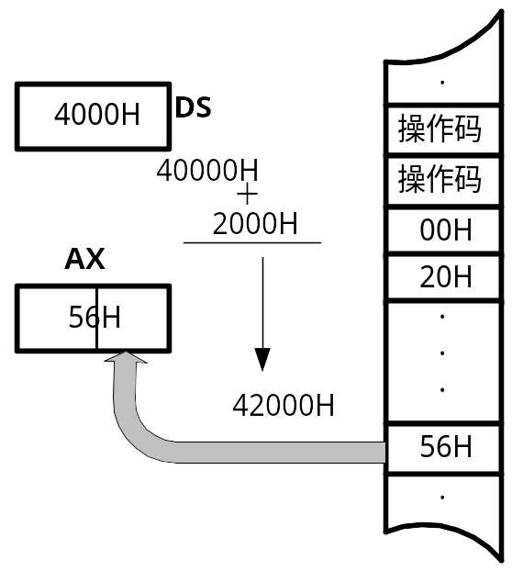
3.1.1 Operand-addressing Mode (6/8)
3） direct addressing直接寻址
  MOV AL，DS:[2000H] ；
  Copy data from data segment DS:2000 to register AL。
  2000H is EA(Effective address偏移量)
    若段基址DS=4000H，则段起始物理地址为4000H左移4位，即40000H，此指令将数据段中物理地址为42000H 单元的内容56H传至AL寄存器。
201001V1.1
Notes:
When it comes to directly addressing, things get a little bit more complex. In the instruction, we declare explicitly that the constant in the square brackets is the offset in the data segment. To get the absolute, not relative address in the virtual memory, we need first shift the number in ds left for 4bits, then plus the offset 2000h, the summary is the address where the data is located in the memory unit. Finally CPU will read one byte for this address and store it in al. the key word direct here means we can get the address directly by add an constant offset to the data segment address.
20位地址，左移4位，错位相加

Slide 19
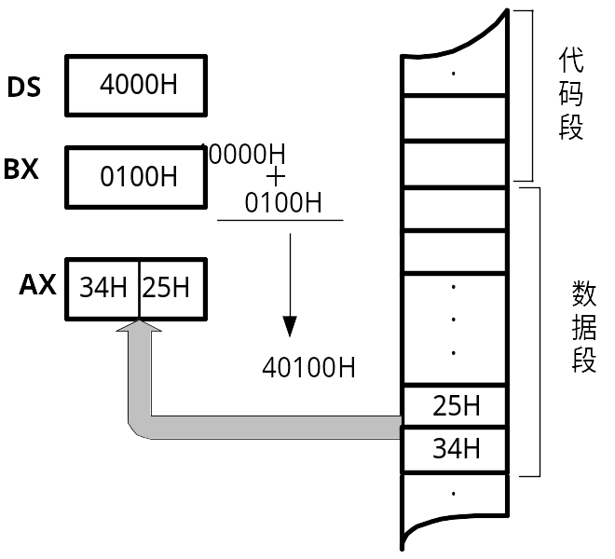
3.1.1 Operand-addressing Mode (7/8)
4） register indirect addressing寄存器间接寻址
  MOV AX，[BX] ；BX contains EA。
201001V1.1
Notes:
Register indirect addressing functions the similar way as direct addressing mode except the effect address or so called offset is stored in a register. First shift the address in DS left for 4 bits, then add with the offset in bx and get the final address. You should pay attention that there is no data type issues in this instruction, but the register itself indicates how many bytes should be read from the memory location. MOV [BP],DL will copy DL into the stack segment memory location addressed by bp.

Slide 20
3.1.1 Operand-addressing Mode (8/8)
5)Register relative Addressing寄存器相对寻址方式
  MOV AL，[EBP+8] ;BP表示操作数2存放在栈段中
  MOV [EBP-4], CX
6)base-plus-index addressing基址变址寻址方式
  MOV AX，[BX+SI]
  BX contains base address and SI contains index.
7) base relative-plus-index addressing 相对基址变址寻址方式
  MOV AH，[BX+DI+1234H]
quiz
201001V1.1

Slide 21
3.1 8086 Instructions
3.1 8086 Instructions
  3.1.1 Registers in CPU
  3.1.2 Operand-addressing Mode
  3.1.3 Instruction Set
201001V1.1
Notes:
Let’s begin with operand-addressing mode. What is the addressing mode ?

Slide 22
3.1.2 Instruction Set(1/18)
Instructions Set
  CPU related
  Opcode：操作码
    The operations/Opcode/操作码 that the CPU can support
  Operand：操作数/操作数的地址
    Also define the method in which Operand are accessed(访问操作数的模式,register /mem/imm)
Opcode Operand
201001V1.1
Notes:
Before we encode the assembly language to machine code, we take a look at how the machine and assembly instructions are represented. The instruction is made up of two parts, opcode and operand. Opcode tells the CPU what to do, and the operand tells where are the data. For example, a+b will be formulate as +, a and b , and where to access a and b, from memory or registers.
Opcodes are defined strictly by the manufacturer of the CPU. compilers can generate the correct codes according to these standard. Because the opcodes for CPUs of different types are different, applications compiled for one CPU type will not work on another.

Slide 23
3.1.2 Instruction Set(2/18)
8086 Instruction Set: classified according to their functions
  1) Data transforming/数据传送类
  2) Arithmetic operation/算术运算类
  3) Bits and logic operation/位与逻辑运算类
  4) String operation/字符串处理类
  5) Branch and loop/控制转移类
  6) CPU control/处理器控制类
    A. Function:指令的基本功能
    B. Affection:指令的执行对Flag R/ PSW 标志位的影响
    C. Data-addressing mode: 寻址方式
    D. Limitation: 寄存器使用上的要求和限制
201001V1.1
Notes:
We sort instructions to six classes according to their function. No matter what instruction it is, it involves four issues, they are function, affection to the flags, data addressing mode and limitations of registers usage. We will detail on this when refer to a specific instruciton.

Slide 24
3.1.2 Instruction Set(3/18)
1) Data transforming/数据传送类
  MOV (Move )
  PUSH (Push data onto stack ), POP (Pop data from stack )
    PUSH AX
    POP BX
  LEA (Load Effective Address )
201001V1.1
Notes:
The most common data transforming instructions are MOV, we have already talked about, push and pop, employed to store or retrieve data from the last-in, first-out stack and lea, loads effective address of a memory location. PUSH AX means AH will be moved into the stack segment memory location addressed by SP-1, while the AL into SP-2; POP BX will cause the first two bytes of data be removed from stack and the first byte moved into BL, and the second byte into BH. Its totally a reverse process of PUSH. Here we are going to skip the instruction lea and discuss later.

Slide 25
3.1.2 Instruction Set(4/18)
2) Arithmetic operation/算术运算类
  CMP (Compare operands )
  ADD (Add), ADC (Add with carry), INC (Increment by 1)
  SUB (Subtraction ), SBB (Subtraction with borrow ), DEC (Decrement by 1 ),
  MUL (Unsigned multiply ), IMUL (Signed multiply )
  DIV (Unsigned divide), IDIV (Signed divide )
201001V1.1
Notes:
Addition appears in many forms in the microprocessor, such as ADD, ADC and INC. all these operations go on to effect the flag register. ADC instruction adds the carry bit to the operand data. This instruction mainly appears in software that adds numbers that are wider than the size of register. For example, if you want to add a 34 bits data, you should first add the lowest 32bits, and add the highest 2 bits with the carry bit.
CMP instruction is a subtraction that changes only the flag bits, without the destination operand. CMP is normally followed by a conditional jump instruction, which tests the condition of the flag bits.
CBW and CWB are used to extend byte to word and word to double word with the sign bit. Such as 9a will be extended to ff9a by CBW.

Slide 26
3.1.2 Instruction Set(6/18)
4) String operation/字符串处理类
  MOVSB (Move byte from string to string)
  STOSB (Store byte in string ), LODSB (Load byte)
  Prefix: REPxx (Repeat CMPS/MOVS/SCAS/STOS )/REPZ
201001V1.1
Notes:
These are string operations, STOS is what you are going to use often. STOS instruction store data in AL,AX or EAX at the extra segment memory location addressed by the DI rigister.

Slide 27
3.1.2 Instruction Set(7/18)
0040D729 lea edi,[ebp-50h] ;edi ebp-50h
0040D72C mov ecx,14h ;loop counter
0040D731 mov eax,0CCCCCCCCh ;tag
0040D736 rep stos dword ptr [edi]
; write the value of eax to memory location addressed by edi for ecx times, edi automatically increases 4 in each iteration.
201001V1.1
Notes:
These four instructions are a segment taken from a program, used to fill 80 bytes at the extra segment with a special tag cch.
The first instruction stores ebp-50h as the effective address of extra segment in register edi.
The second instruction stores the cycle time in Cx, who works as an cycle counter and decreased 1 automatically after each iteration.
The third one stores the special tag in EAX.
The fourth one is the most important. Rep indicates the stos instruction will be executed 14h times.
And the stos instruction stores data in EAX at the extra segment memory location addressed by the DI rigister.
Such piece of code is used to intialize the stack frame for a new function on stack. Lets see what happened before execute the first instruction in the function main by using the disassembly window.
You can easily find that these 4 instructions will be executed before the instruction y=6.
Stack frame will be detailed in the 6th lecture.

Slide 28
3.1.2 Instruction Set(8/18)
5) Branch and loop/控制转移类
  JMP (Jump)
  Jxx (Jump if condition)/JE,JNE; JS,JNS; JO,JNO; JC,JNC; JP,JNP;JB,JNB; JA,JNA (unsigned); JG,JNG,JL,JNL (signed)
  CALL (Call procedure)
  RET (Return from procedure )
the PC can be changed by the above instructions负责取指的指令指针寄存器可被上述指令修改
201001V1.1
Notes:
Branch instructions can be classified into two categories depending on whether a conditional flag is needed. JMP is an unconditional jump instruction and the following ones are conditional jump. The Call instruction redirects the flow to the procedure just called by changing the ip and even cs registers. The CALL instruction differs from the jump instruction by saving a return address on the stack. (The return address return control to the instruction that immediately follows the CALL in a program when a RET instruction executes.)

Slide 29
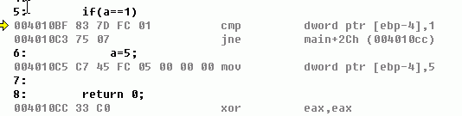
3.1.2 Instruction Set(9/18)
Branch Instructions Example
if (a == 1) {
a = 5;
}
CMP subtracts the second operand from the first but, unlike the SUB instruction, does not store the result; only the flags are changed.
JNE Jump if not equal. Test ZF=0.
201001V1.1
Notes:
Now we are going to interpret the branch instruction of if , if-else and while.
The if instruction is translated to a cmp instruction followed by a conditional jump instruction.
CMP subtracts the second operand from the first … if the flag indicates the two operands are not equal then the flow of the program will be transferred to the address
follows the opecode. Otherwise the statements in the braces will be executed.

Slide 30
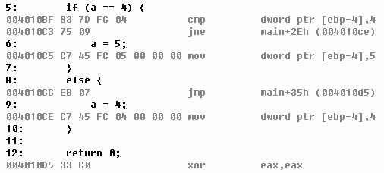
3.1.2 Instruction Set(10/18)
if (a == 4) {
a = 5;
} else {
a = 4;
}
Jump Instruction
EIP 004010CC
EIP 004010D5
201001V1.1
Notes:
The if-else example is a little more complex than the previous one in two points. First , if not equal the program flow will be redirected to address where 4 will be assigned to a memory location. if equal, the program will assign 5 to a and jump to the end of the branch instructions.
The JMP instruction transfers control to a different point in the instruction stream without recording return information

Slide 31
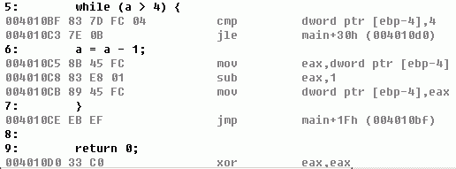
3.1.2 Instruction Set(11/18)
Loops are constructed by compilers in terms of jumps and branches
while (a > 4) { a = a - 1; }
201001V1.1
Notes:
This while example is the most complex one, and you can find that the Loops are constructed by compilers in terms of jumps and branches.
First a cmp instruction is used to test the condition, if the condition is met, then execute the statements and jump back unconditionally to the compare instruction.
If not met, which means a is less or equal to 4, the flow of the program will be directed to the end of the branch instruction.
JLE
Jump if less or equal ( ZF(zero flag)=1 and SF(sign flag) <>OF(overflow flag) )

Slide 32
Unit 3. Representation of Code
3.0 Intro
3.1 X86 Instructions
3.2 x86 Assembly Language Programming
3.3 Disassembly in VS C++IDE
3.4 Machine Code
201001V1.1
Notes:
Like any other programming language, instructions alone can not make a program. So we are going to discuss more on directives, macros, function calls and program structures.
就像其它任何一种语言一样，光有指令是无法完成一个完整的程序，宏定义，程序结构，库调用等等

Slide 33
3.2 Assembly Language Introduce(1/4)
Assembly Language : CPU related
  The set of mnemonics/助记符 accepted by an assembler for a specific CPU type became known as the assembly language for that CPU type
201001V1.1
Notes:
Assembly language is CPU related. The set of …read.

Slide 34
3.2 Assembly Language Introduce(2/4)
Assembler VS Compiler
  Similar:
    translate one "language" into another
  Dissimilar:
    analyzing meaning or not
    having choice or not
    See CSAPP 3.6.6
hello.c
Compiler
hello.s (optional)
hello.o
(text)
(binary)
hello.s
Assembler
hello.o
(text)
(binary)
201001V1.1
Notes:
The assembler and compiler both translate one language into another, but the compiler is more smart and complex, since it analyzes the meaning of the code and optimize the program by generating smaller sized executable file or improving the execution efficiency. But the assembler only translate the instruction to machine code according to the manufacturer ‘s guideline. Some assemblers may also be able to perform some simple types of instruction set-specific optimizations .

Slide 35
3.2 8086 Assembly Language(3/4)
The difference(GAS Style vs MASM Style)
  两者的源操作数和目的操作数的位置相反
  前者的汇编指令中带有后缀（如b/w/l），指示操作数的长度(8/16/32 bits)
  前者在寄存器前加“％”，在常数和符号地址前加“$”
  前者间接寻址用( )表示，而后者用[ ]表示
E.g.:
  movl %edx,%eax mov eax,edx
  movl (%edx),%eax mov eax,[edx]
201001V1.1
Notes:
But there are some differences in representation between GAS and MASM. If you’re interested in this topic, read the contents on this page after class.

Slide 36
3.2 8086 Assembly Language(4/4)
Example: Adding and Subtracting Integers
;TITLE Add and Subtract (AddSub.asm)
; This program adds and subtracts 32-bit integers.
.686
.MODEL FLAT, STDCALL;stdcall为API调用时右边的参数先入栈
.STACK
.CODE
main PROC
mov eax,10000h ; EAX = 10000h
add eax,40000h ; EAX = 50000h
sub eax,20000h ; EAX = 30000h
ret
main ENDP
END main
201001V1.1
Notes:
In this program, we add 4 instructions which carry out some arithmetic operation and call a function from irvine32.inc.
What does DumpRegs do?
Include 指令注意路径 include /masm32/include/windows.inc

Slide 37
Unit 3. Representation of Code
3.0 Brief Introduction
3.1 X86 Instructions
3.2 x86 Assembly Language Programming
3.3 Disassembly in VS C++IDE
3.4 Machine Code
201001V1.1

Slide 38
3.3 Disassembly in VS C++IDE(3/6)
Register Allocation：
  The compiler would like to be able to allocate a register for every variable in the source program, because every variable that lives in a register speeds up the program's execution by some amount
  CPU has a few registers，when and how to use each register as a surrogate/代用品 for which variable.
  Who do it
    Assembly level：programmer him/herself
    C level：Compiler
201001V1.1
Notes:
Here is the efficiency issue. ….
When writing high-level, the compiler will do the allocation job for us especially when the optimization option is set. But writing low-level means the programmer himself should in charge of the register allocation and optimization. You should read the following pages for more information after class.

Slide 39
3.3 Disassembly in VS C++IDE(4/6)
How the compiler finish this job
  register allocation is so difficult that compilers do not try to allocate registers in the best way possible
  Why?
    The conflict: the best way meaning
      long time to analyzing and thinking,
      and the result will not easy to be understood
201001V1.1

Slide 40
3.3 Disassembly in VS C++IDE(5/6)
Optimization level
  The extent to which compilers optimize register allocation depends on the optimization level
    High: [after development ]
      result in more aggressive optimizations which take longer to compile
      be difficult, both for people and for debuggers, to relate the resulting machine code to the original source code
    Low: [during development ]
      result in slow execution
201001V1.1

Slide 41
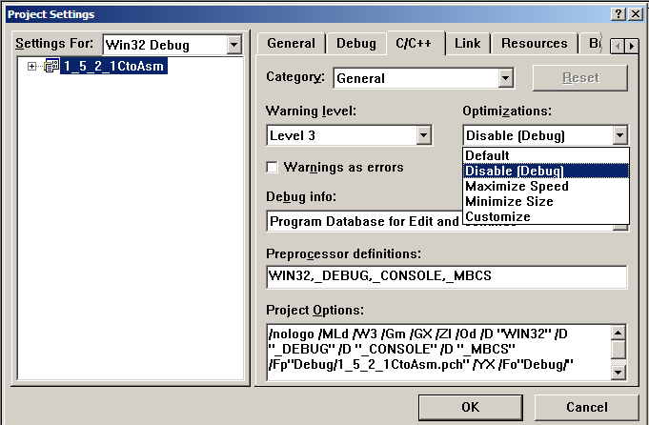
3.3 Disassembly in VS C++IDE(6/6)
Setting
201001V1.1
Notes:
优化可能会对汇编代码造成的修改，见程序员的自我修养
P47有一部分

Slide 42
3.3 Disassembly in VS C++IDE(1/6)
In this course, we will not focus on Assembly Language programming.We will pay more attention to Disassembly/反汇编
Disassembly
  Useful tool for examining object code
  Produces approximate rendition(翻译) of assembly code
  Analyzes bit pattern of series of instructions
  Can be run on either executable or .o file
    Debug and Release version
201001V1.1
Notes:
Read..

Slide 43
3.3 Disassembly in VS C++IDE(2/6)
In Visual Studio C++, we can Disassembly in two methods
  1)By using the Disassembly Windows when debugging
  2)By creating a Assembly file when compiling
201001V1.1
Notes:
In VC++ 6.0, we can Disassembly in two methods…
The first one is creating a Assembly file when compiling and the setting steps is listed in the following slides. After the configuration, recompile your program, and you will get an assembly file in your debug folder.
the second method have been mentioned already by using the Disassembly Windows.

Slide 44
Unit 3. Representation of Code
3.0 Brief Introduction
3.1 X86 Instructions
3.2 x86 Assembly Language Programming
3.3 Disassembly in VS C++IDE
3.4 Machine Code
201001V1.1

Slide 45
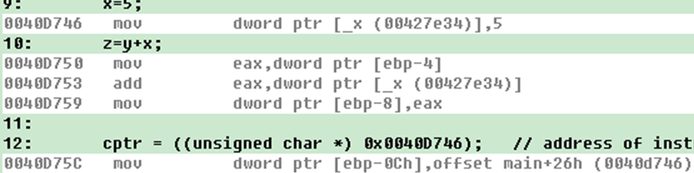
3.4 Machine Code(1/5)
One way to inspect the machine code
#include <stdio.h>
int x;
void main()
{
int y=6; int z=0; unsigned char *cptr; int i;
x=5;
z=y+x;
cptr = ((unsigned char *) 0x0040D746); // address of instruction ”x=5”
for (i = 0; i < 10; i++) // 0x0040D750-0x0040D746 = 10(decimal)
{ printf("%02X ", *cptr);
cptr++; }//one way to inspect machine code
printf("\n");
}
201001V1.1
Notes:
Here is an example program and we are going to encode it into machine code. The second line in yellow, we define a global variable x without initialization. Successively, we define integer y,z and a char pointer cptr. Then we store the summary of x and y in z. we assign an address like this to the char pointer. In the following iteration, 10 bytes stored successively in this address will be output. This address addresses the machine code x=5 and the machine code is 10 bytes long. Question 1, how could we get the address, 2, how could we figure out the size of the code? The answer is by using the disassembly window in the IDE. Let me show you how to do this.
1. start the IDE. 2. open our project .3 set the break points and debug the program. 4 and click the icon in the debug toolbar and bingo!

Slide 46
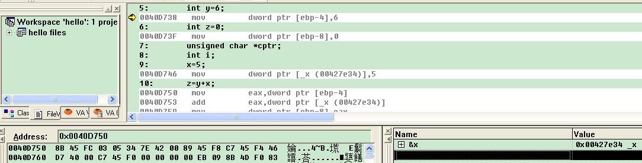
3.4 Machine Code(2/5)
Another way to inspect the machine code
  Using memory window
201001V1.1
Notes:
Lets inspect the code in memory to verify the translation result. First open the memory window by push the memory button on the debug toolbar, then input the address here. Click the enter key and memory window will be redirected to the exactly location we required. And you can these 3 bytes are the same as we encoded.

Slide 47
3.4 Machine Code(3/5)
Now try to get the machine code of the following assembly code
MOV EAX,0xdeadbeaf
PUSH 0x004012CC
RET
How？
201001V1.1

Slide 48
3.4 Machine Code(4/5)
In Code Blocks:
int main()
{
asm( "MOV 0xdeadbeaf,%EAX");
asm ("PUSH 0X0028FE60");
asm ("ret");
return 0;
}
In VS
int main()
{
_asm {
mov EAX, 0xdeadbeaf
push 0X0028FE60
ret }
return 0;
}
201001V1.1

Slide 49
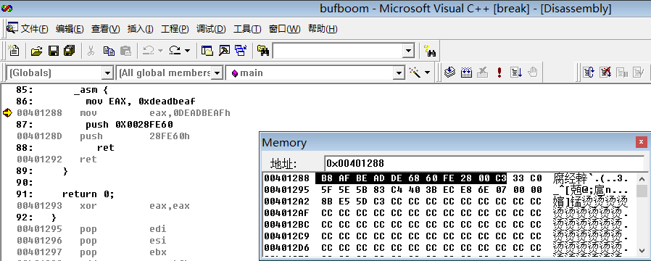
3.4 Machine Code(5/5)
Set break point before instruction MOV in your c program, then debug it.
201001V1.1

